Slide 1

Finger Vein Based Biometric Identification Using Convolutional Neural Networks
by
Saquib Nawaz 170081601035
Varun Kumar K 170081601038
Under the guidance of
Dr . G. Kavitha
Associate Professor, Department of Information Technology
B.S. Abdur Rahman Crescent Institute of Science & Technology, Vandalur, Chennai – 600 048

Slide 2
INTRODUCTION
Finger Vein recognition system is a method of biometric authentication that process the finger vein image, so that we can find the accurate information of that particular individual.
It uses NIR (Near InfraRed) light imaging in order to detect the finger veins. In our finger vein, the hemoglobin in the blood absorbs the NIR light from the vein authentication device, which makes the vein image to appear as dark lines of pattern.
We use both index and middle fingers for vein authentication. In case, if the quality of the vein image is not good in either finger, then we can go for the thumb for identification and verification.
Even though we have lots of biometric methods such as facial recognition, iris recognition, palm vein recognition, etc, the finger vein authentication has better false acceptance rate (FAR) than any other biometric methods. Finger vein biometric method is one of the best and highly accurate method to reduce forgery and increase security.

Slide 3
AIM
To reduce the fraud in applications such as automated teller machines, credit card authentication and to enhance the public safety, a finger vein biometric identification is designed and developed that applies pattern recognition techniques based on the image of the finger vein patterns.

Slide 4
OBJECTIVES
To increase the accuracy of Finger Vein biometric technique, we can reform the pixel density in the finger vein patterns.
To reduce the EER( Equal error rate), repetitive line tracking technique is used.
To design a improved version of Convolutional neural network in order to attain high security.
To achieve above mentioned in real-time scenarios.

Slide 5
SCOPE
With the fast development in the field of electronic information technology, the identity verification and security of data is a critical main problem.
Due to this fact, the biometric recognition has gaining popularity as it provides a high security, reliable and robust approach for personal identification.
As a new biometric technique, finger vein recognition has been done.

Slide 6
LITERATURE SURVEY
AUTHOR(S) | PAPER TITLE | CONTRIBUTION | INFERENCE
K. S. Itqan, A. R. Syafeeza, F. G. Gong, N. Mustafa, Y. C. Wong and M. M. Ibrahim | User Identification system based on finger vein patterns using Convolutional neural network IEEE Transactions On Pattern Analysis And Machine Intelligence, Vol. 43, NO. 1, January 2021, July 2019 DOP | It aims to provide a brief review of the feature extraction methods applied in finger vein recognition. It highlights the limitations of the existing. feature extraction methods | The design of large scale datasets(big data) that will permit the training and validation of customized CNN models from scratch is of paramount importance towards the development of more reliable finger vein biometric system.
Rig Das, Emanuela Piciucco, Emanuele Maiorana, and Patrizio Campisi | Convolutional Neural Network for Finger-Vein-based Biometric Identification CVPR Workshop on Computer Vision for Augmented and Virtual Reality, Seattle, WA, USA, 2020 | The use of human finer vein traits for the purpose of automatic user recognition provides good performance, yet it depends upon the quality of the finger vein images. The accuracy achieved with this approach is 87.6%. | The identification accuracy of the proposed network significantly increases with the employed number of training images. The use of multiple session’s data for training can improve the achievable identification accuracy.

Slide 7
AUTHOR(S) | PAPER TITLE | CONTRIBUTION | INFERENCE
Bakhtiar Affendi Rosdi, Chai Wuh Shing and Shahrl Azmin Suandi | Finger Vein recognition using local binary pattern IEEE/CVF Conference on Computer Vision and Pattern Recognition, Salt Lake City, UT, USA, 2018 | A personal verification method using finger vein is presented in this approach. Here, LLBP (Local Line Binary pattern) is utilized as feature extraction technique. | Extraction of robust features from finger vein images is an important issue in a finger vein based biometric system. The equal error rate(EER) of LLBP (Local line binary pattern) is significantly lower compared to LBP and LDP.
Mohamed Ould Zmirli, Hamza Hentabli, Ismail Boucherit | Finger Vein identification using deeply fused convolutional neural network IEEE/CVF Conference on Computer Vision and Pattern Recognition (CVPR), Seattle, WA, USA, 2020 | This approach allows the biometric traits for personal recognition with high security and accuracy. The crux of this approach is that the CLAHE (contrast limited adaptive histogram equalization) method is obtained, but the image provided is either over enhanced or high contrast. It reduces the accuracy level to 89%. | It overcomes the problem of filters, number of CNN layers and the activation function problem. A small number of training images (less than 4 images) can be used to obtain better accuracy and speed.

Slide 8
EXISTING SYSTEM
In those days, the identity verification and security of data is a fundamental problem. Predominantly, we are using the SVM (Support Vector Machine), in order to find the accuracy of the finger vein using the finger vein biometric authentication system.
Support Vector Machine (SVM) have recently gained excellence in the field of machine learning and pattern classification. Classification is achieved by realizing a linear or non-linear separation surface in an input space.
It initializes the closest pair of points from the opposite classes like the Direct Support Vector Machine algorithm. As soon as the algorithm finds a violating point in the dataset, it greedily adds it to the candidate set.
It may so happen that the addition of the violating point as a Support Vector may be prevented by other candidate Support Vectors that are already present in the set.

Slide 9
EXISTING MODEL (Contd.)
DISADVANTAGES OF EXISTING MODEL:
Accuracy is low.
Computation load is very high.
Feature Extraction is not accurate to the point.

Slide 10
PROBLEM DEFINITION
Analyzing the finger vein images of different quality can reduce the accuracy of biometric authentication and identification.
The quality of the image available for the finger vein must be unique and accurate, if it is not clearly viewed or accurate, then we cannot process with less quality images. So, we need high quality finger vein images to be taken as input images.
Since the accuracy level is less, the efficiency of the project also becomes low.

Slide 11
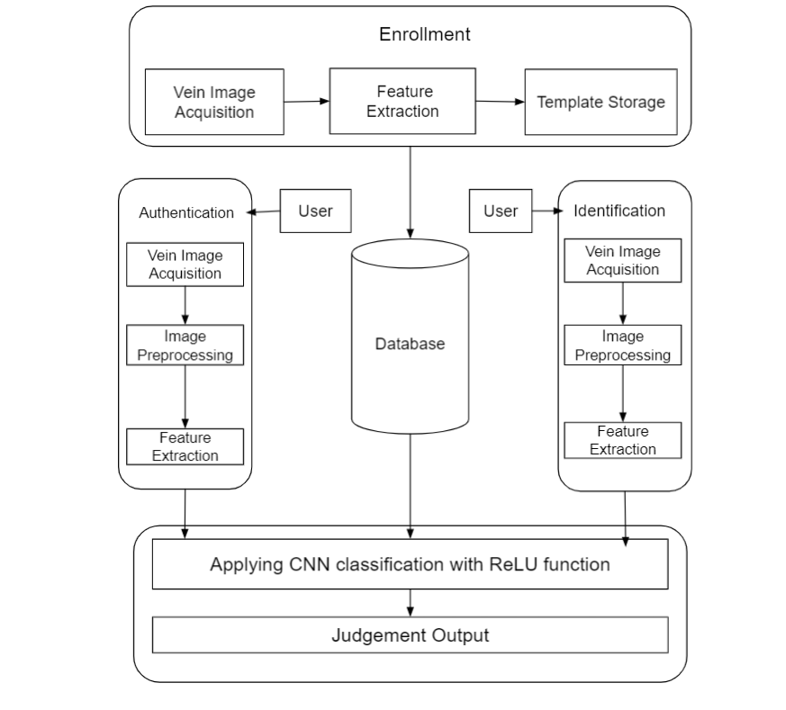
OVERALL ARCHITECTURE DIAGRAM
FIG. DIAGRAMMATIC REPRESENTATION OF FINGER VEIN BIOMETRIC IDENTIFICATION SYSTEM

Slide 12
LIST OF MODULES
MODULE 1 → PREPROCESSING:
Input images gathered from publicly available databases, are pre-processed for ROI extraction and image enhancement.
The preprocessing image captured by acquisition process itself introduces “Noise”. This images need to be processed.
Moreover, two different sensors of the same object will produce different images.
Preprocessing helps to upgrade the quality of the captured image and founded on the rules that define how the blood vessel network will be segmented.
Finger vein preprocessing basically includes : extraction of Region of Interest (ROI), segmentation and combination of filters.

Slide 13
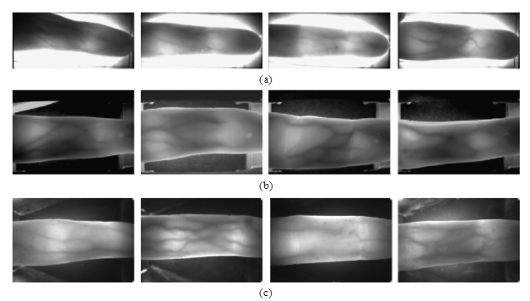
FIG. INPUT IMAGES FROM 3 DIFFERENT PUBLICLY AVAILABLE DATASETS

Slide 14
MODULES (Contd.)
MODULE 2 → EXTRACTION OF REGION OF INTEREST (ROI):
The left and right end areas are usually the thick part of the finger or fingernail where the lighting is inadequate.
As the vein patterns in these areas are not captured accurately and are not useful for recognition, these areas are removed by using combination of filters.
Then, noise, is removed using a component labeling method to obtain an image. The vein-patterns in the black region inside the finger area cannot be observed due to bright lighting, and this region is filled with the average value of the surrounding pixels using a 4 × 20 mask in order to create an ROI mask.

Slide 15
MODULE 3 → FEATURE EXTRACTION
INTENSITY FEATURES:
Intensity feature is often used as the primary source of image information in thoracic CT images.
TEXTURE FEATURES:
Texture descriptor can be a characterized property of nodule surfaces such as contrast, regularity, coarseness and structural arrangement.
The extraction of texture features has various methods such as GLCMs, LBP, Gabor filter and fractal dimension. A hybrid method is proposed for extracting texture features. GLCMs, LBP and Gabor filter are integrated to improve the discriminating power of texture features.

Slide 16
CONTINUED…
GEOMETRIC FEATURES:
Several 2D geometric features are computed from the segmented modules. Major axis length and minor axis length are the major and minor axes lengths of the bounding ellipse of the module, respectively.
The perimeter is the perimeter of a module multiplied by pixel resolution. Area is the number of nodule pixels encompassed by the module region at the maximum area slice multiplied by the pixel spacing.

Slide 17
MODULE 4 → CLASSIFICATION
Classification is used to associate the appropriate class label (type of texture) with the blood test sample in the finger vein by using the distance measurements.
The selection of prominent features plays an important role in reducing the computational complexity of a classifier.
The training data are used for updating the weights. Nonlinear mapping functions transform the nonlinear separation problem in the input plane into a linear separation problem in feature space, facilitating easier classification in the high dimensional feature space.

Slide 18
CONTINUED…
CONVOLUTION LAYER:
Convolution layer is the first layer to extract features from an input image. It preserves the relationship between pixels by learning the image features using small squares of input data. It is a mathematical operation that takes two inputs such as image matrix and a filter or kernel.
With the convolution of an image, we can execute operations such as sharpening, edge detection and blurring by applying different filters.
PADDING:
Sometimes, filter does not perfectly fit the input image. We have two options: Pad the picture with zeros (zero-padding) so that it fits.
Drop the part of the image where the filter did not fit. This is called valid padding which keeps only valid part of the image.

Slide 19
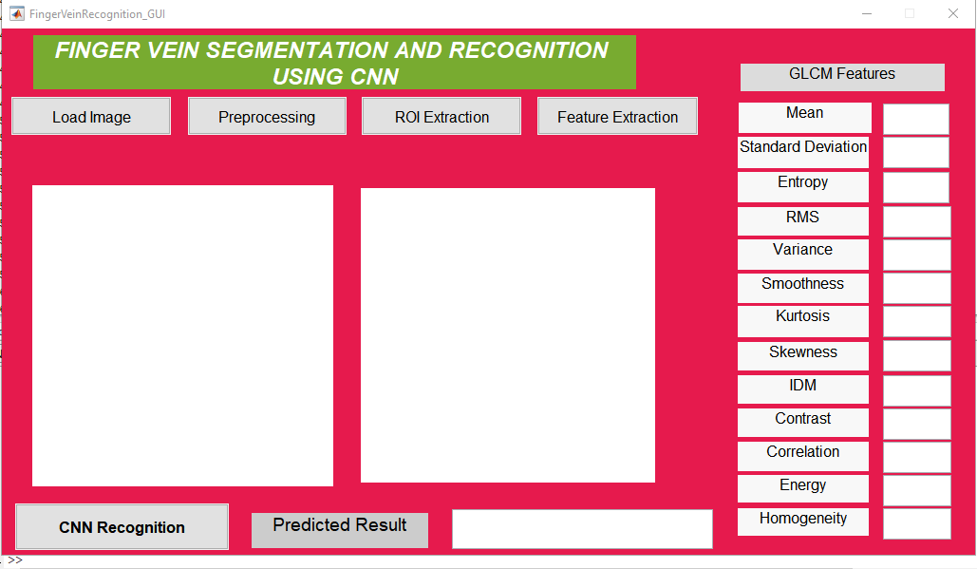
IMPLEMENTATION
FINGER VEIN GUI

Slide 20
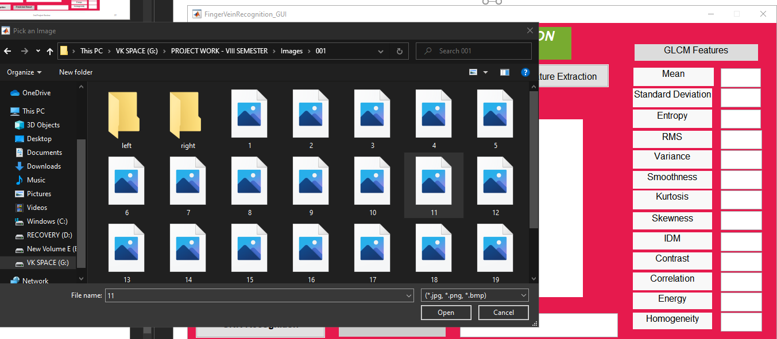
IMPLEMENTATION (CONT…)

Slide 21

IMPLEMENTATION (Contd.)

Slide 22
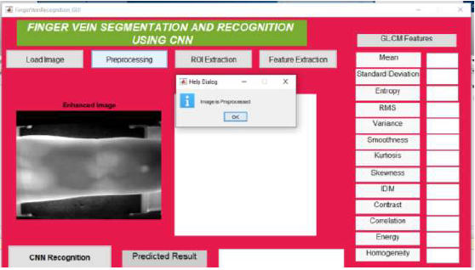
IMAGE PREPROCESSING

Slide 23
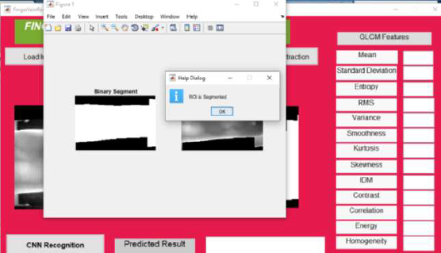
EXTRACTION OF ROI

Slide 24
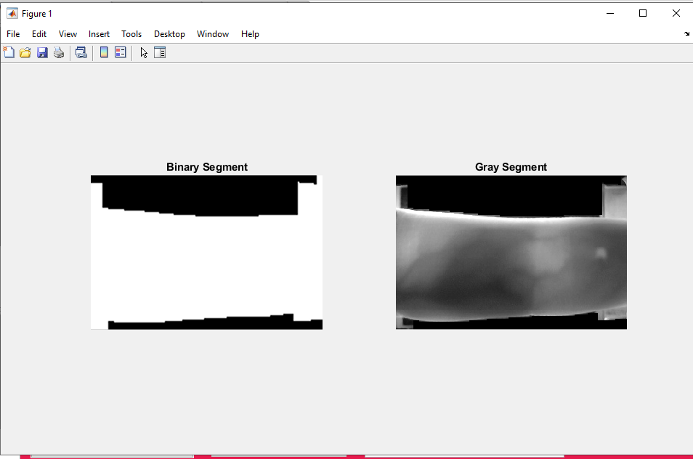
BINARY SEGMENT & GRAY SEGMENT

Slide 25
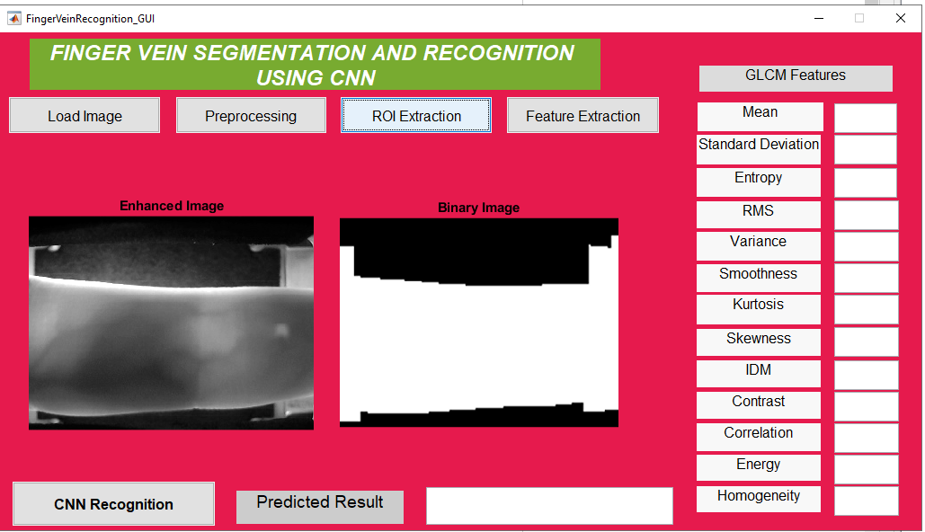
ENHANCED IMAGE

Slide 26
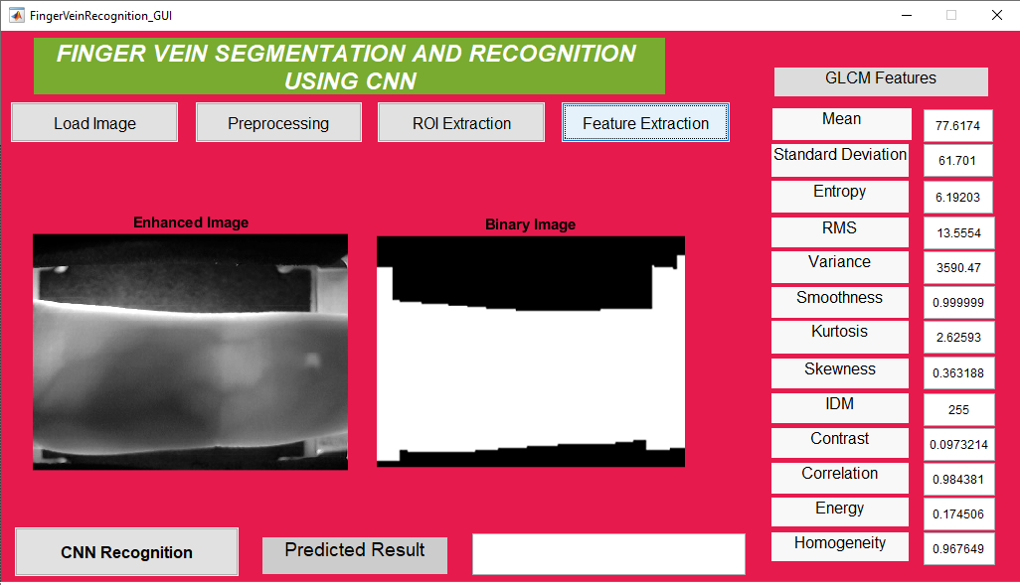
FEATURES OF EXTRACTION

Slide 27
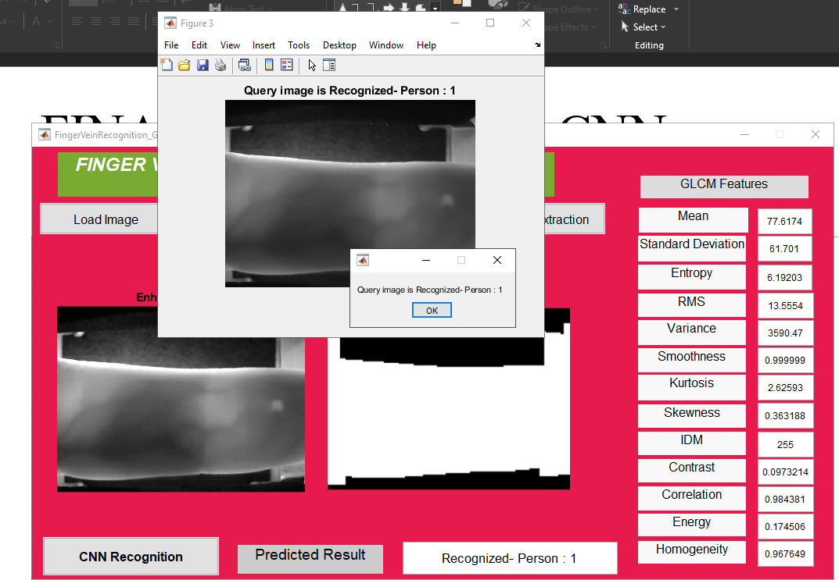
FINAL RESULT

Slide 28
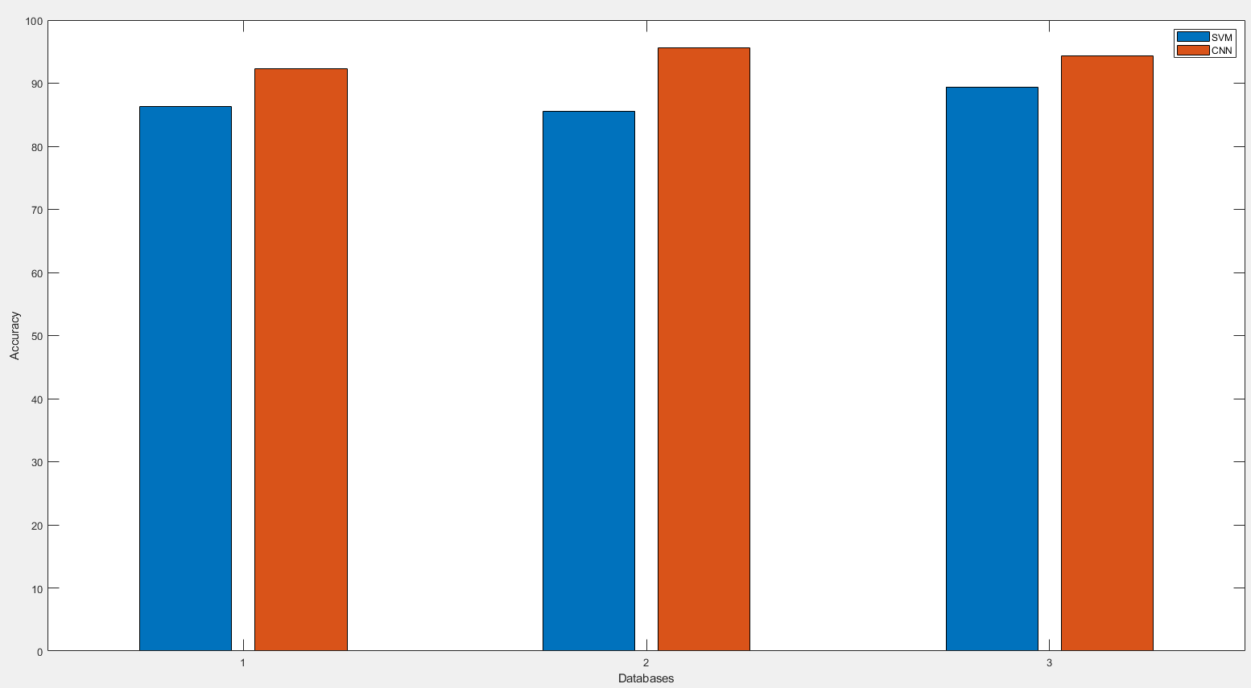
RESULT (COMPARISON CHART)

Slide 29
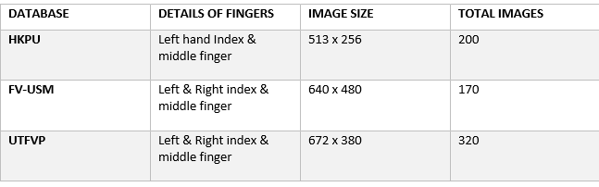
DATASET

Slide 30
DEMO VIDEO

Slide 31
CONCLUSION AND FUTURE WORK
Finger vein based biometric recognition system that uses proposed CNN approach is powerful to finger-vein asymmetric and shading, is researched by using the vein images that are captured with the finger vein recognition system. Under environmental conditions, the CNN was applied on the output in order to check whether the input image is recognized or not. The performance is checked based on the comparison between existing model (SVM) and proposed CNN with the help of three publicly available databases. Based on the output of our project, the final result can be done by recognizing the input image and matching it with the databases. Lots of training data are needed to effectively train the proposed CNN model. It is difficult to collect lots of finger vein images data without training. Hence, it is important to increase training data by appropriate data increase, that represents the uniqueness of training data. In order to lower the defect and hurdle of the finger vein based biometric method, we have made our trained CNN model with three public database that are extended to other researchers through the proposed CNN method that can be put in other biometric methods, and the performance can be evaluated.
In our future work, we would like to conduct research on other biometric methods with the CNN that is proposed in our study and it will be done on a real-time scenario basis.

Slide 32
REFERENCES
[1] R. F. Amine Nait-Ali, Signal and image processing for biometrics, 2018.
[2] T. hafes, Reconnaissance biomtrique multimodale base sur la fusion en score de deux modalits biomtriques: lempreinte digitaleet la signature, 2018.
[3] C.Wilson, Vein pattern recognition: a privacy-enhancing biometric. CRCpress, 2017.
[4] S. Damavandinejadmonfared, A. K. Mobarakeh, S. A. Suandi, and B. A. Rosdi, Evaluate and determine the most appropriate method to identify finger vein, Procedia Engineering, vol. 41, pp. 516521, 2014.
[5] I. Claude, J.-L. Daire, and G. Sebag, Fetal brain mri: segmentation and biometric analysis of the posterior fossa, IEEE Transactions on Biomedical Engineering, vol. 51, no. 4, pp. 617626, 2016.

Slide 33
THANK YOU

